Slide 1
Commercial Reference Acquisition Process

Slide 2
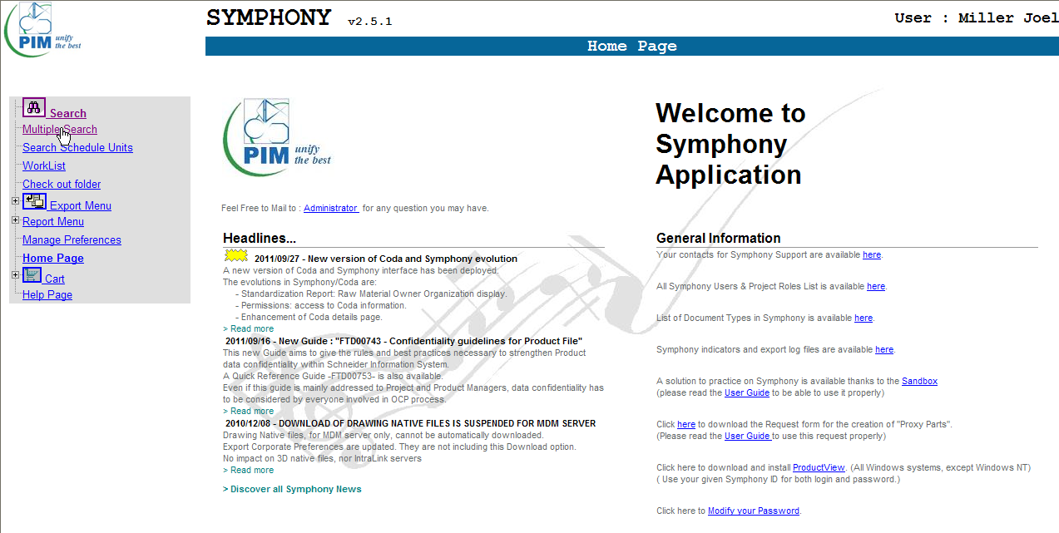
1. In Symphony, select “Multiple Search”

Slide 3
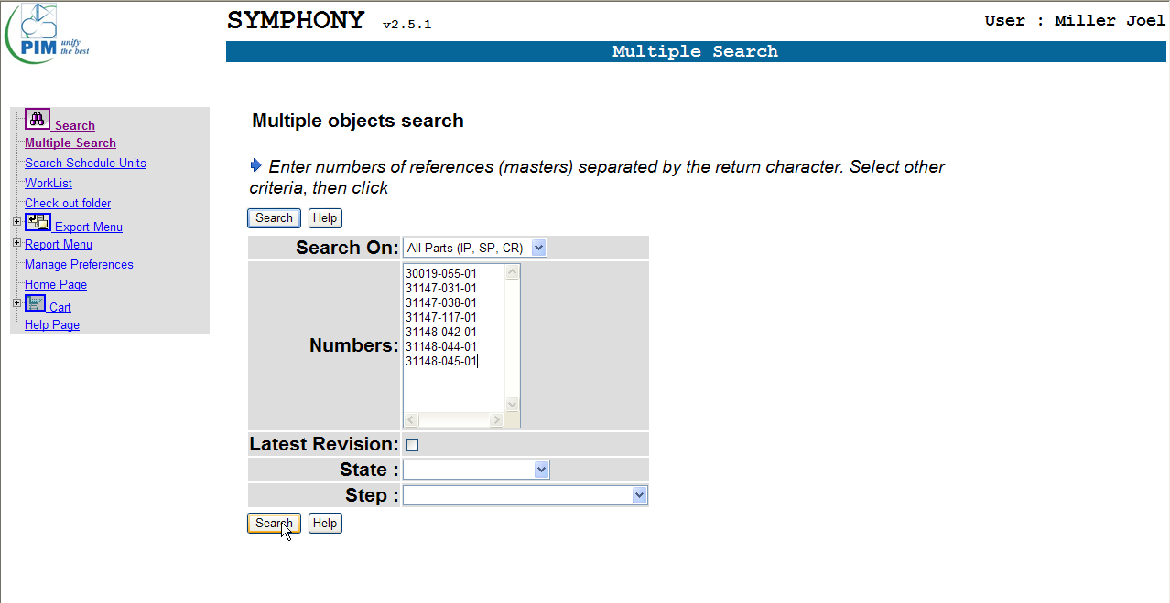
2. Copy and paste your complete list of parts in the box labeled “Numbers” and select “Search” button.

Slide 4
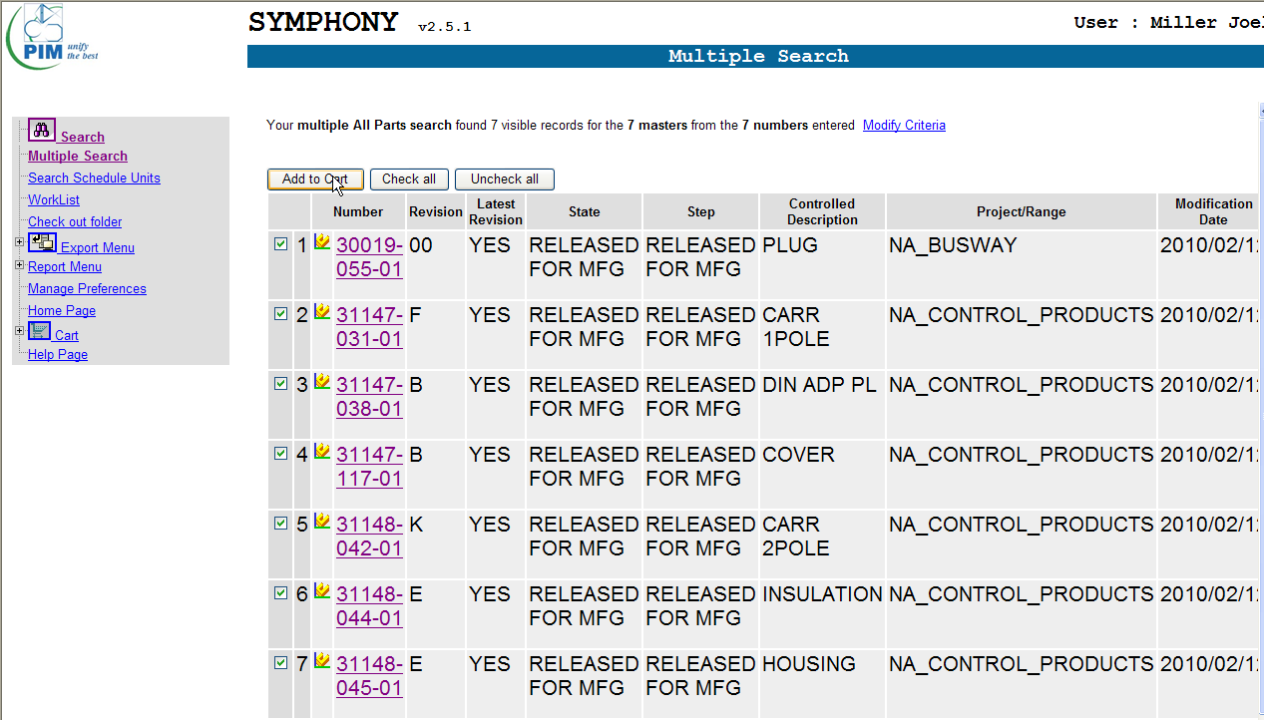
3. Make sure all boxes are checked and select the “Add to Cart” button

Slide 5
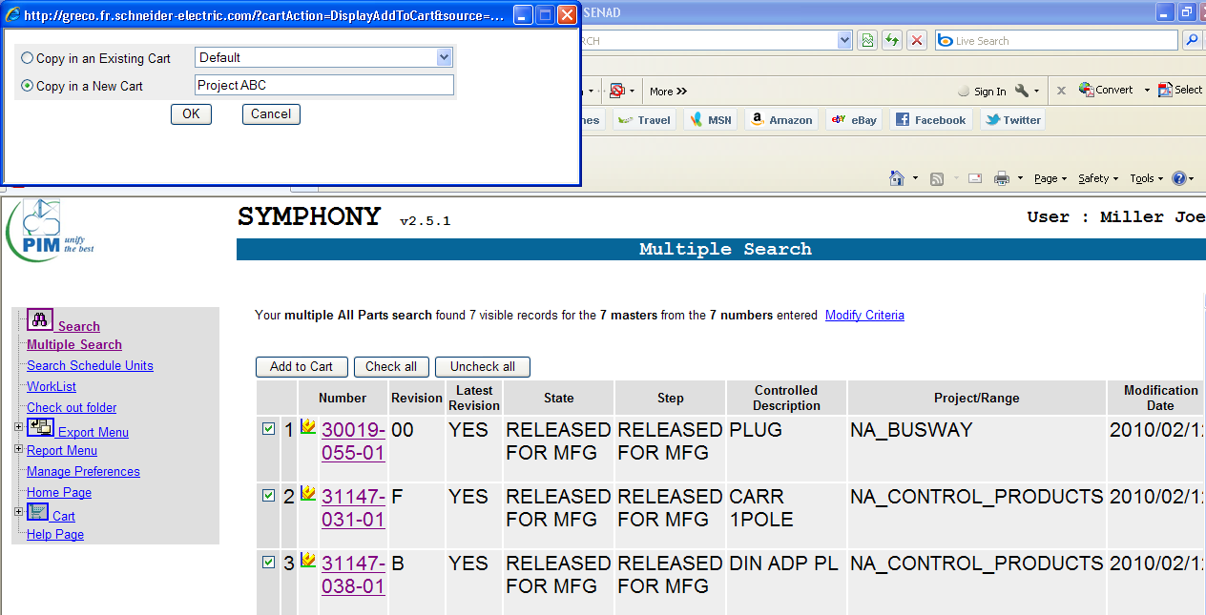
4. Select either copy in Existing Cart or New Cart and select OK button

Slide 6
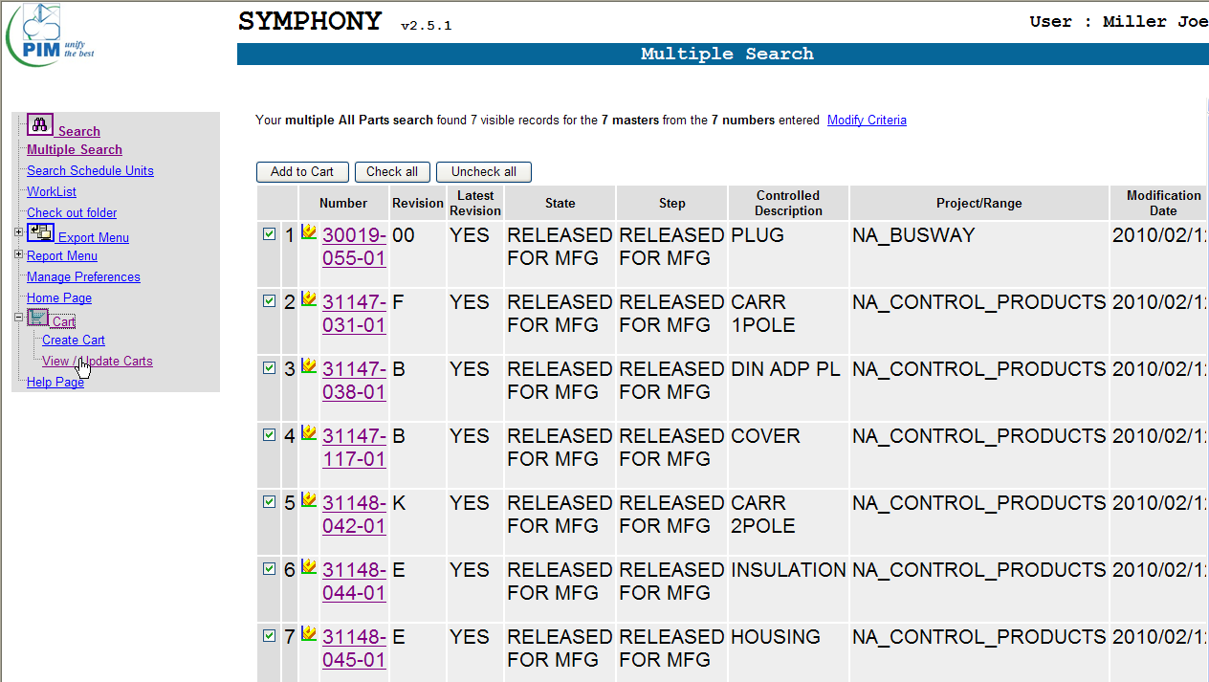
5. Select “View / Update Carts”

Slide 7
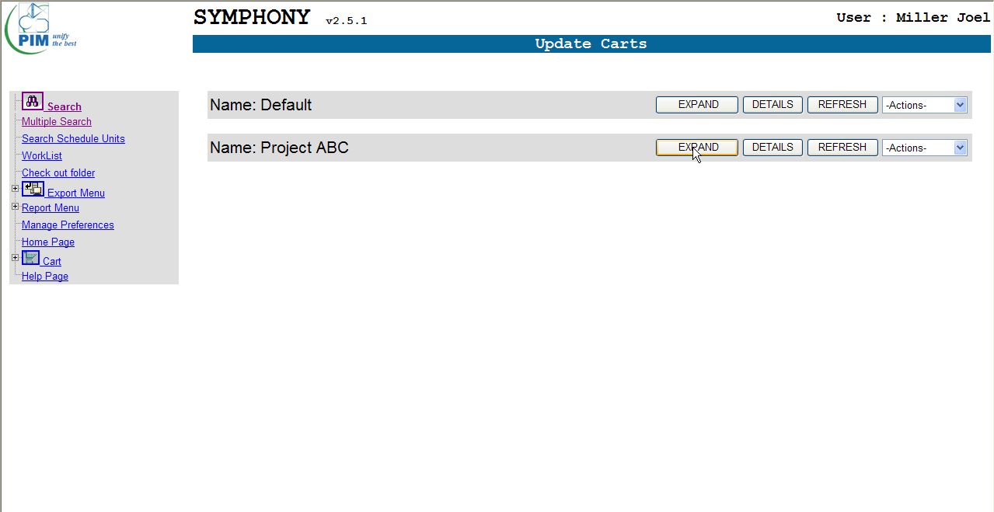
6. Select “Expand” to see contents of cart

Slide 8
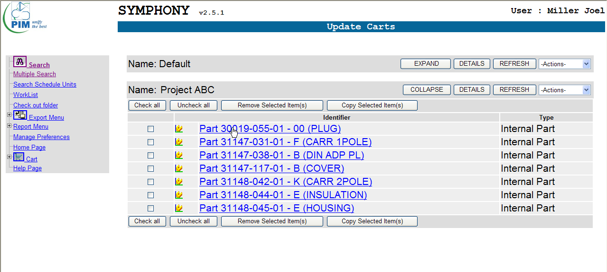
7. Select part from list for your search

Slide 9
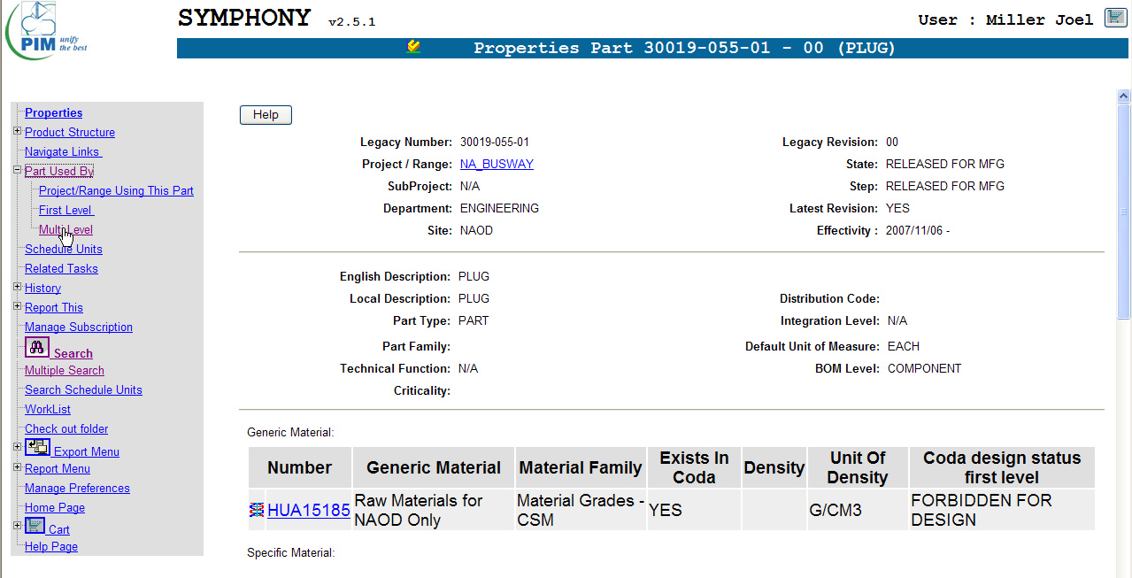
8. Select “Part Used By => Multi Level to generate a list of the where used for the part

Slide 10
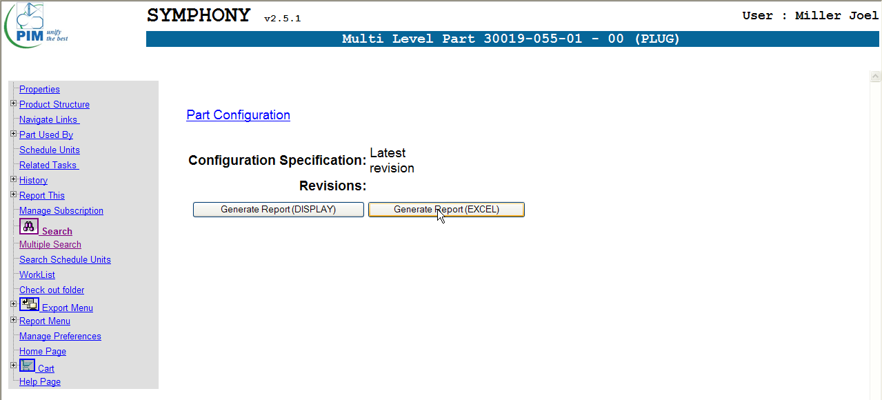
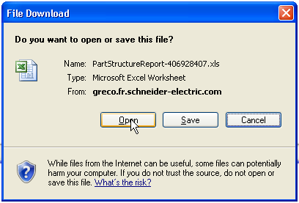
9. Select “Generate Report” and then “Open” to load where used into an EXCEL spreadsheet to be sorted

Slide 11
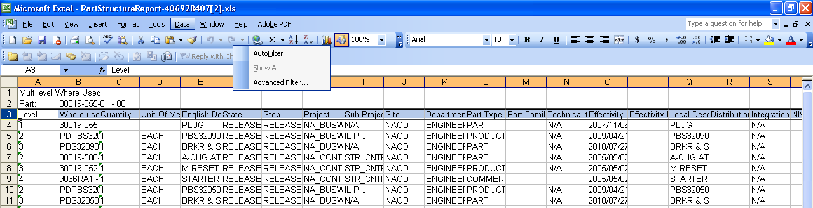
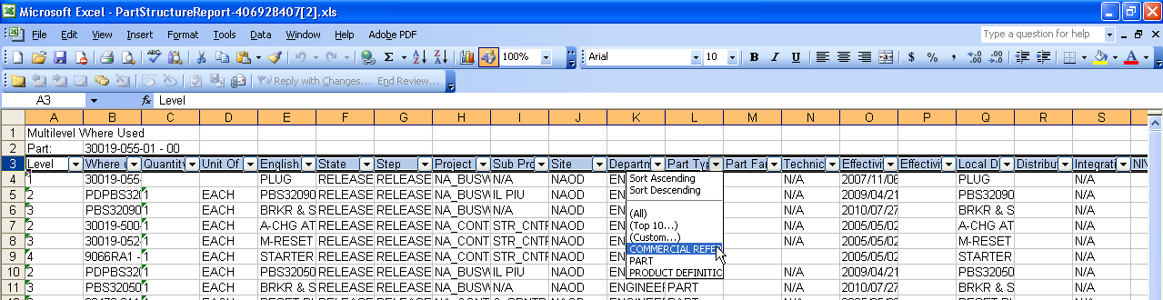
10. Select the column label row (row 3) and apply “Data => AutoFilter”. Then select column labeled “Part Type” and sort by “COMMERCIAL REFERENCE”.

Slide 12
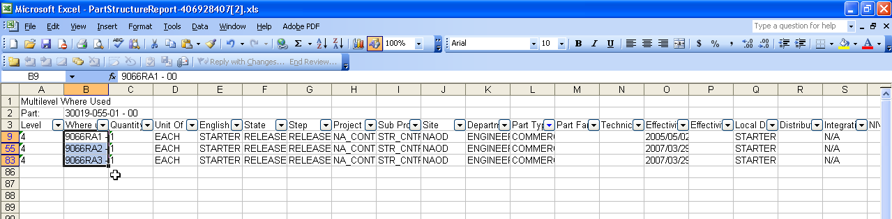
11. The “Commercial References” will be located in the column labeled “Where Used” as shown below

Slide 13
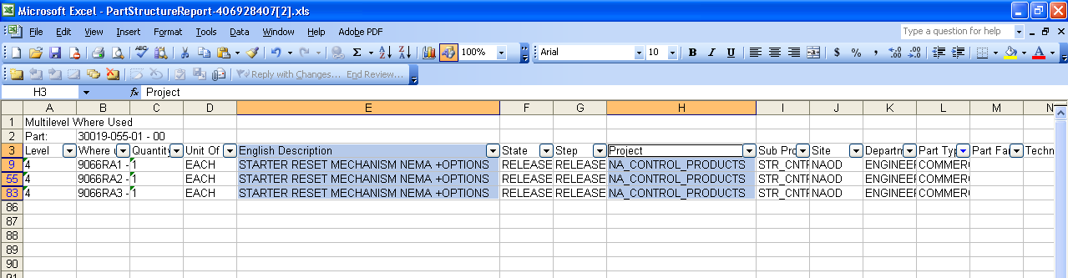
CONSIDERATIONS:
Not all parts will be found within Symphony
These parts will not be included in the list derived from your “Multiple Search” step in the process and thus will not be included in your cart. There is no warning to that effect so make sure you match the commercial references to the correct part if transferring information from the spreadsheet generated by Symphony to another spreadsheet.
Not all parts have a commercial reference
The process for these parts will follow the same path until you go to sort by “COMMERCIAL REFERENCE” for which there will be none. For these parts, I will typically make note of the information within the column labeled “English Description” and “Project” as shown below. This will help to identify the BOC and Product Group to which the part belongs.
Process can be time consuming
Once proficient, you can expect to take ~3 minutes on average for each part in your list. A large “where used” list will impact the time required. I have asked the Symphony experts to develop an “Extra Service” process for obtaining this information using their resources but nothing is available at this time.

